Slide 1
5. Dynamic Networks
5.1 Historical dynamic networks
5.2 Focused time-delay neural network
5.3 Distributed time-delay neural network
5.4 Layer recurrent network
5.5 NARX network
5.6 Computational power of dynamic networks
5.7 Learning algorithms
5.8 System identification
5.9 Model reference adaptive control
5.10 MATLAB Live Script examples

Slide 2
Introduction
Time
An essential ingredient of the learning process
Important for many practical tasks: speech, vision, signal processing, control
Many applications require temporal processing
Time series prediction
Noise cancelation
Adaptive control
System identification
...
Linear systems → well-developed theories
Nonlinear systems → neural networks have the potential to solve such problems

Slide 3
Introduction
How can we build time into the operation of neural networks?
Extending static neural networks into dynamic neural networks → networks become responsive to the temporal structure of input signals
Networks become dynamic by adding
TEMPORAL MEMORY and/or FEEDBACK
Feedback loop

Slide 4
Static vs. dynamic networks
Neural network categories
Static networks → structural pattern recognition
Feedforward networks
No feedback elements, no delays
Output is calculated directly from the input through feedforward connections
Dynamic networks → temporal pattern recognition
Output depends on
current input to the network
also on previous inputs
previous network output
previous network states
Dynamic networks can be divided into two categories
Networks that have only feedforward connections
Networks with feedback or recurrent connections
A need for short-term memory and feedback

Slide 5
Memory
Memory
Long-term memory
Acquired through supervised learning and stored into synaptic weights
Short-term memory
Temporal memory, useful to capture temporal dimension
Implemented as time delays at various parts of the network
Long-term memory

Slide 6
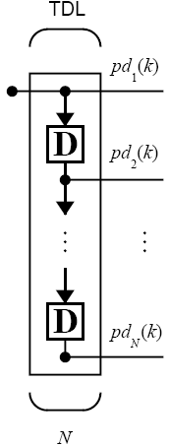
Tapped delay line
The simplest form of short-term memory
Already mentioned in linear adaptive filters
Most commonly used for dynamic networks
Tapped delay line (TDL) consists of N unit delay operators
Output of TDL is an N+1 dimensional vector, composed of current and past inputs

Slide 7
5.1 Historical dynamic networks
Hopfield (1982)
Elman (1990)
Jordan (1986)
Notes:
Images: Ben Krose, Patrick van der Smagt (1996) An Introduction to Neural Networks

Slide 8
Hopfield network
Hopfield network (Hopfield, 1982)
Network consists of N interconnected neurons which update their activation values asynchronously and independently of other neurons
All neurons are both input and output neurons
Activation values are binary (-1, +1)
Multiple-loop feedback system → interesting to study the stability of the system
Primary applications
Associative memory
Solving optimization problems

Slide 9
Jordan network
Jordan network (Jordan, 1986)
Network outputs are fed back as extra inputs (state units)
Each state unit is fed with one network output
The connections from output to state units are fixed (+1)
Learning takes place only in the connections between the input to hidden units as well as hidden to output units
Standard backpropagation learning rule can be applied to train the network

Slide 10
Elman network
Elman network (Elman, 1990)
Similar to the Jordan network, with the following differences:
Hidden units are fed back (instead of output units)
Context units have no self-connections
context units

Slide 11
5.2 Focused time-delay neural network
The most straightforward dynamic network → feedforward network + tapped delay line at input
Temporal dynamics only at the input layer of a static network
Nonlinear extension of linear adaptive filters
Backpropagation training can be used
The structure is suitable for time-series prediction

Slide 12
MATLAB Live Script example
NN5b_NAR_network.mlx
Design a nonlinear autoregressive (NAR) neural network for the recursive prediction of chaotic Mackay-Glass time series.
Objective
Design Focused time-delay neural network for recursive one-step-ahead predictor
Fixed network parameters
Number of hidden layers = 1
Hidden layer activation functions = Logistic
Output layer activation function = Linear
Variable network parameters
Input delays = ?
Hidden layer neurons = ?
Notes:
This is an introduction to the example NN5b_NAR_network.mlx
Mackay-Glass time series represents a nonlinear (chaotic) dynamic system.
We wish to construct a predictor for recursive one-step-ahead prediction.
Some network parameters are chosen as fixed, and others are open to experimentation (variable network parameters).

Slide 13
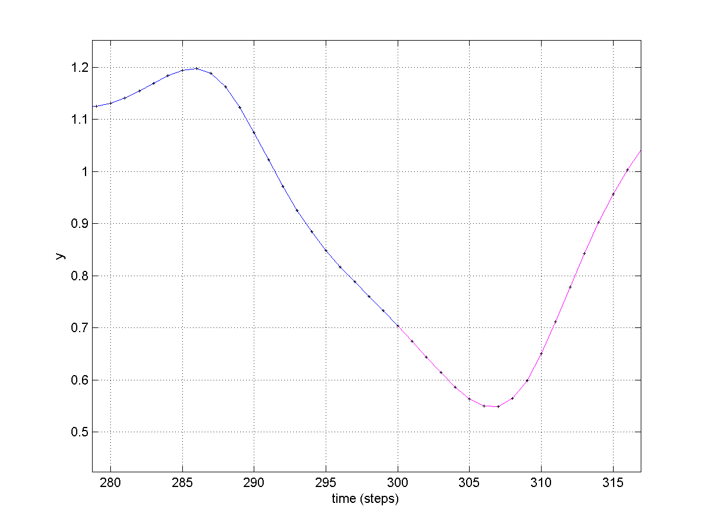
Understanding input delays
Input delays = [0 6 12] → Inputs {x(t), x(t-6), x(t-12)}
Prediction horizon = 1 → Output x(t+1)
Known world
Input delays = [0 6 12]
Unknown world
Prediction horizon = 1
Notes:
The slide graphically presents the meaning of choosing input delays for the neural network predictor.

Slide 14
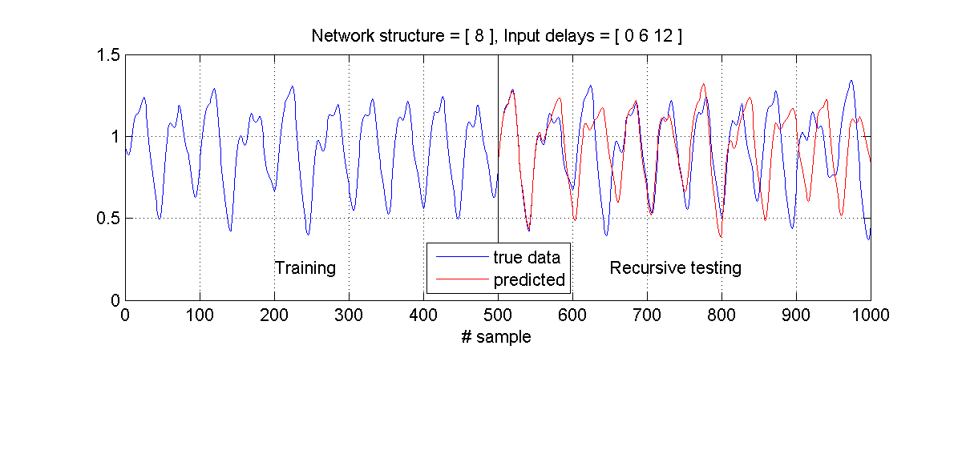
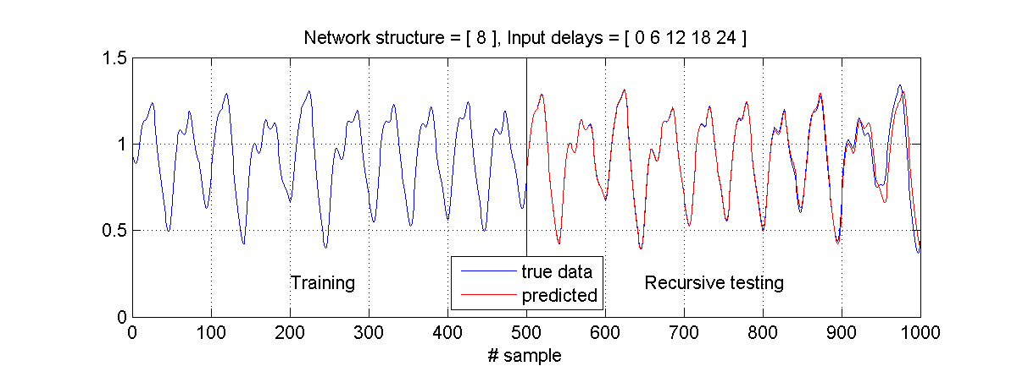
Results with 8 hidden neurons and different input delays
(A)
(B)
Notes:
Results for different configurations are shown. The upper graph shows a less successful solution, and the lower graph shows a very good solution with accurate multi-step ahead predictions.

Slide 15
5.3 Distributed time-delay neural network
Tapped delay lines distributed throughout the network
Distributed temporal dynamics → ability to handle non-stationary environments
Backpropagation training cannot be used anymore → the need for temporal backpropagation
Possible applications: → phoneme recognition, recognition of various frequency contents in signals

Slide 16
Temporal backpropagation
Backpropagation algorithm
Suitable for static networks and focused time-delay neural networks
Temporal backpropagation
Supervised learning algorithm
Extension of backpropagation
Required for distributed time-delay neural networks
Computationally demanding
Which form of backpropagation to use?
Based on the nature of the temporal processing task
STATIONARY ENVIRONMENT → Standard backpropagation + Focused time-delay neural networks
NON-STATIONARY ENVIRONMENT → Temporal backpropagation + Distributed time-delay neural networks

Slide 17
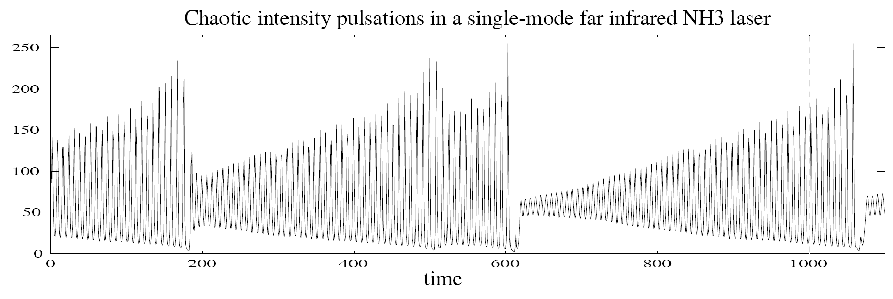
Example (1/2)
Wan (1994): Time series prediction by using a connectionist network with internal delay lines
Winner of the “Santa Fe Institute Time-Series Competition”, USA (1992)
Task: Nonlinear prediction of a nonstationary time series exhibiting chaotic pulsations of NH₃ laser

Slide 18
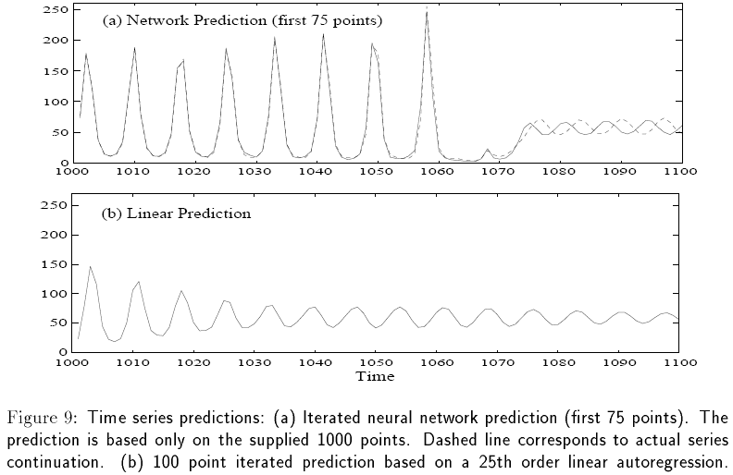
Example (2/2)
Prediction results

Slide 19
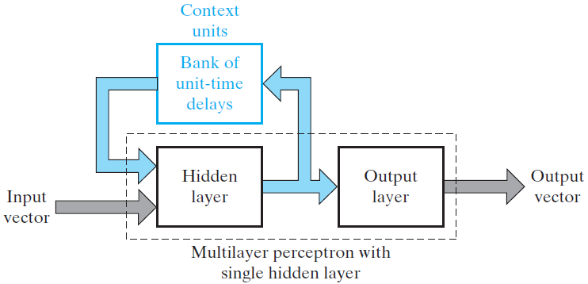
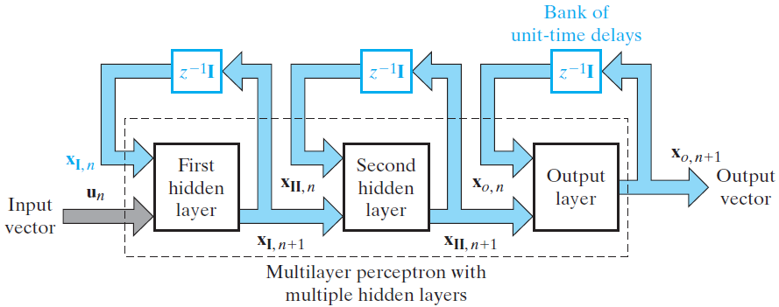
5.4 Layer recurrent network
Layer recurrent network = Recurrent multilayer perceptron
One or more hidden layers
Each computation layer has a feedback link
Notes:
Images: Simon Haykin (2009) Neural Networks and Learning Machines, 3rd ed. (p. 795-796)

Slide 20
Layer recurrent network structure
Feedback loop with a single delay for hidden layer
Can be trained by backpropagation
Elman (1990)

Slide 21
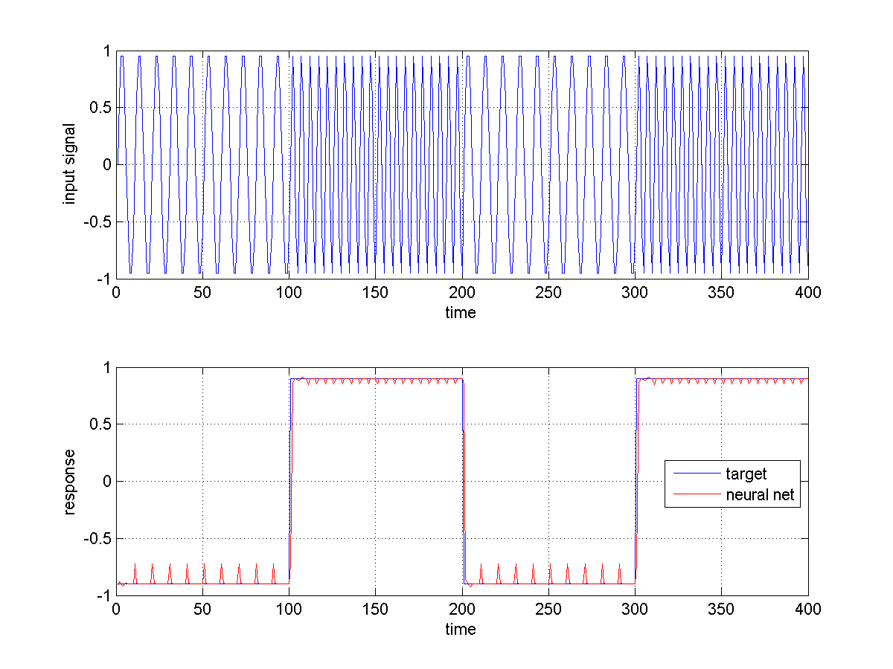
Example (1/3)
Phoneme detection problem
Recognition of various frequency components
Layer recurrent network
1 hidden layer
8 neurons
5 delays

Slide 22
Example (2/3)
Network training
Successful recognition of two “phonemes”

Slide 23
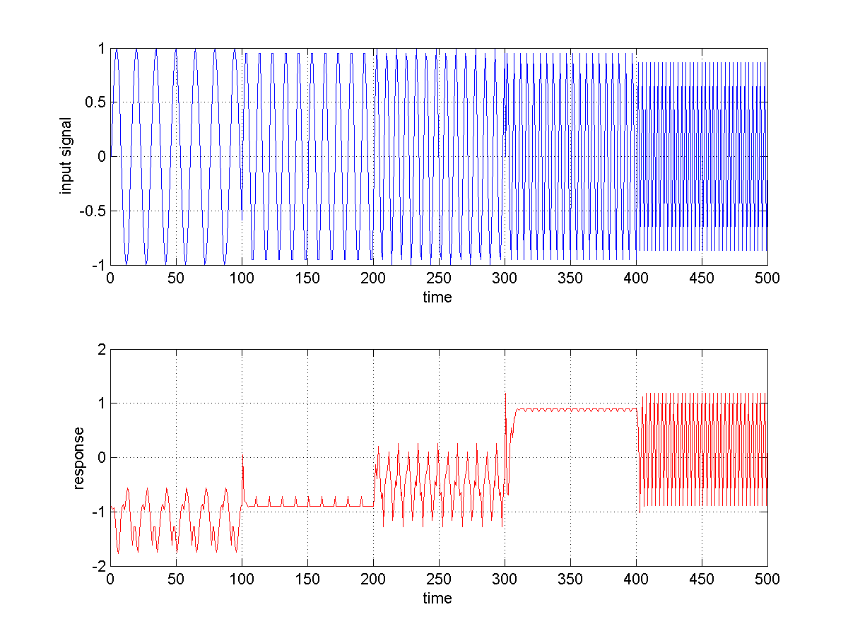
Example (3/3)
Network testing
Unreliable generalization, works only on trained phonemes
OK
OK

Slide 24
5.5 NARX network
Networks discussed so far
Focused or distributed time delays
Feedback only localized to specific network layers
NARX = Nonlinear AutoRegressive Network with EXogenous Inputs
Recurrent network with global feedback
Feedback over several layers of the network
Based on the linear ARX model
Defining equation for the NARX model
Output y is a nonlinear function of past outputs and past inputs
Nonlinear function f can be implemented by a neural network

Slide 25
NARX structure
NARX network with global feedback
Possible application areas
Nonlinear prediction and modeling
Adaptive equalization of communication channels
Speech processing
Automobile engine diagnostics

Slide 26
NARX training considerations
NARX output is an estimate of the output of some nonlinear dynamic system
Output is fed back to the input of the feedforward neural network → parallel architecture
True output is available during training → possible to create series-parallel architecture
True output is used instead of feeding back the estimated output
Advantages of series-parallel architecture for training
Training input to the feedforward network is more accurate → improved training accuracy
The resulting network is purely feedforward → static backpropagation can be used

Slide 27
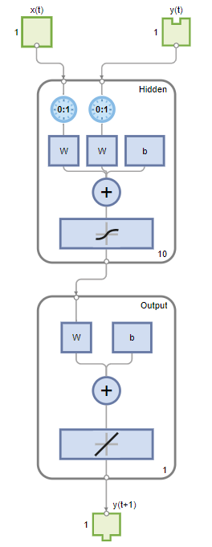
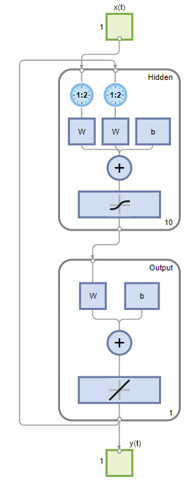
MATLAB demo
Maglev Modeling
This example illustrates how a NARX neural network can model a magnet levitation dynamical system.
A) Open-loop training configuration B) Closed-loop configuration for recursive prediction
Notes:
Please refer to Maglev Modeling, https://uk.mathworks.com/help/deeplearning/ug/maglev-modeling.html

Slide 28
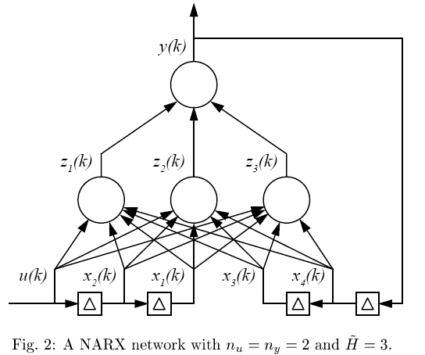
5.6 Computational power of dynamic networks
Fully and partially connected recurrent networks

Slide 29
Theorems
Theorem I (Siegelmann & Sontag, 1991)
All Turing machines* may be simulated by fully connected recurrent networks built on neurons with sigmoid activation functions. *Turing machine is a theoretical abstraction that is functionally as powerful as any computer
Theorem II (Siegelmann et. al. 1997)
NARX networks with one layer of hidden neurons with BOSS* activation functions and a linear output neuron can simulate fully connected recurrent networks with BOSS* activation functions, except for a linear slowdown *BOSS = bounded, one-sided saturated function
Corollary to Theorem I and II
NARX networks with one hidden layer of neurons with BOSS* activation functions and a linear output neuron are Turing equivalent.

Slide 30
5.7 Learning algorithms
Two modes of training for recurrent networks
Epochwise training
For a given epoch, the recurrent network starts running from some initial state until it reaches a new state, at which point the training is stopped and the network is reset to the initial state for the next epoch
METHOD: Backpropagation through time
Continuous training
Suitable if no reset states are available or online learning is required
Network learns while it is performing
The learning process never stops
METHOD: Real-time recurrent learning

Slide 31
Backpropagation through time
Extension of the standard backpropagation algorithm
Derived by unfolding the temporal operation of the network into a layered feedforward network
The topology grows by one layer at every time step
EXAMPLE: unfolding the temporal operation of a 2-neuron recurrent network

Slide 32
Backpropagation through time example (1/2)
Nguyen & Widrow (1989): The truck backer-upper
Notes:
https://doi.org/10.1109/IJCNN.1989.118723

Slide 33
... example (2/2)
Generalization
Training

Slide 34
5.8 System Identification
System identification = experimental approach to modeling the process with unknown parameters
STEP 1: Experimental planning
STEP 2: Selection of a model structure
STEP 3: Parameter estimation
STEP 4: Model validation
Unknown nonlinear dynamical process → dynamic neural networks can be used as an identification model
Two basic identification approaches:
System identification using a state-space model
System identification using an input-output model
Notes:
Chapters "5.8 System Identification" and "5.9 Model-reference adaptive control" present examples of applications of dynamic networks.

Slide 35
System identification using a state-space model
“State”
A vital role in the mathematical formulation of a dynamical system
State of a dynamical system is defined as a “set of quantities that summarizes all the information about the past behavior of the system that is needed to uniquely describe its future behavior, except for the purely external effects arising from the applied input.”
Plant description by a state-space model
State:
Output:
f, h: unknown nonlinear vector functions
Two dynamic neural networks can be used to approximate f and h

Slide 36
State-space solution to the identification problem
Neural network (I)
Identification of plant state
State must be physically accessible!
Neural network (II)
Identification of plant output
Actual state x(n) is used as input rather than the predicted output
Both networks are trained by gradient descent → minimizing error signals e_{I} and e_{II}
Notes:
Images: Simon Haykin (1999) Neural Networks: A Comprehensive Foundation, 2nd ed. (p. 799)

Slide 37
System identification using an input-output model
If the system state is not accessible → identification by input-output model
Plant description by an input-output model
f is unknown nonlinear vector function
Input-output formulation is equivalent to NARX formulation
NARX neural network can be used to approximate f
q past inputs and outputs should be available

Slide 38
Input-output solution to the identification problem
NARX neural network can be used as a dynamic identification model
Series-parallel learning
system output is used as feedback, not the predicted output
Parallel architecture for application

Slide 39
5.9 Model-reference adaptive control
Dynamic networks are important for feedback control systems
MULTIPLE PROBLEMS:
Nonlinear coupling of plant state with control signals
Presence of unmeasured or random disturbances
Possibility of a nonunique plant inverse
Presence of unobservable plant states
MRAC = Model reference adaptive control
Well suited for the use of neural networks
Possible control methods:
Direct MRAC
Indirect MRAC
Notes:
Chapters "5.8 System Identification" and "5.9 Model-reference adaptive control" present examples of applications of dynamic networks.

Slide 40
MRAC using direct control
Unknown plant dynamics → adaptive learning
Controller + plant = closed-loop feedback system
Controller and plant build externally recurrent network
How to get plant gradients → indirect control
Notes:
Images: Simon Haykin (1999) Neural Networks: A Comprehensive Foundation, 2nd ed.

Slide 41
MRAC using indirect control
Two-step procedure to training the controller
Identification of the plant (identification model)
Using the plant model to obtain dynamic derivatives to train the controller
Controller and plant model build externally recurrent network
Notes:
Images: Simon Haykin (1999) Neural Networks: A Comprehensive Foundation, 2nd ed. (p. 803)

Slide 42
Summary
Focused time-delay neural network
Distributed time-delay neural network
Layer recurrent network
NARX network

Slide 43
5.10 MATLAB Live Script examples
NN5b_NAR_network.mlx
Design a nonlinear autoregressive (NAR) neural network for the recursive prediction of chaotic Mackay-Glass time series.

